Slide 1
Optimizing Revenue and Operations at Big Mountain Resort: A Data-Driven Approach
John Maloney
UMGC Data Science Bootcamp, 2024

Slide 2
Introduction to Big Mountain Resort
Location: Montana
Annual visitors: 350,000
Facilities: 11 lifts, 2 T-bars, 1 magic carpet
Current Situation and Challenges
Recently installed an additional chair lift, increasing costs by $1.54M
Pricing strategy: Adult Weekday/Weekend prices are currently set at $81.00
Concerns: Not fully capitalizing on resort facilities and optimizing pricing

Slide 3
Problem Identification
Big Mountain Resort, Montana invested in chair lift upgrades and wants to optimize their ROI by increasing ticket price, cutting costs and capitalizing on its facilities to cover operating costs.
Project Objective:
Develop a data–driven strategy for optimizing ticket pricing
Explore cost-reduction opportunities
Support decisions on future investments

Slide 4
Recommendation and Key Findings
Pricing Insights
Potential price increase: Model suggests ticket valuation could be up to $92.65 (current: $81)
Caveat: Model’s prediction error rate of +/- $10.35
Revenue Opportunities
Potential additional revenue from $0.54 ticket price increase: $939,815 per season
Additional strategies:
Increasing weekend ticket prices
Offering season pass bundles
Expanding services: premium experiences - guided tours, exclusive access, luxury amenities
Operational Efficiencies
Minimal impact on ticket value by closing up to 5 runs
Potential savings on upkeep with selective run closures
Notes:
Expanding Services: Introduce premium experiences, such as guided tours, exclusive access to certain areas, or luxury amenities like heated chairlifts.
Dynamic Pricing: Implement a dynamic pricing model that adjusts ticket prices based on demand, seasonality, and booking time. For example, offer discounts for early bookings and raise prices during peak periods.

Slide 5
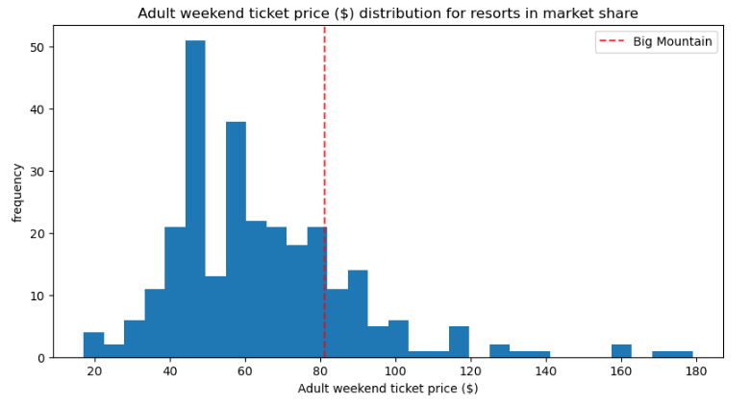
Modeling Results and Analysis
Data Preparation and Exploration
Data cleaning: Removed irrelevant and incomplete data
Exploratory analysis: Identified trends across ski resorts (figure A)
Principal Component Analysis (PCA)
Breakdown of features into components
Identification of significant trends and features with high variance
Figure A: Big Mountain Resort's ticket price, at $81, is around the median compared to the pricing distribution across all resorts in the market.

Slide 6
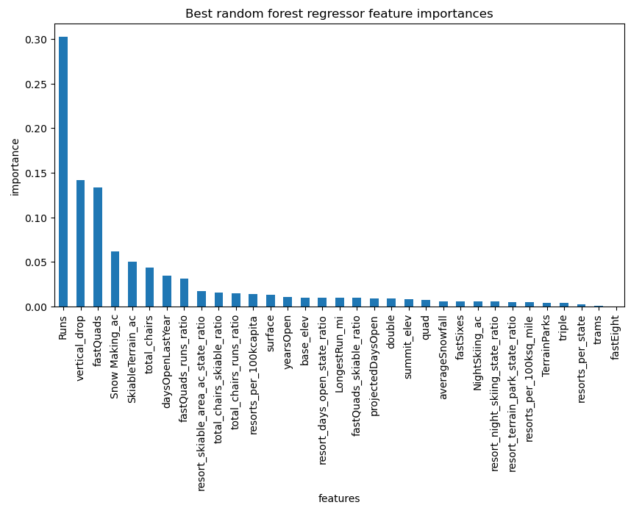
Modeling Results contd.
Machine Learning Models
Models used: Linear Regression and Random Forest
Cross-validation for model refinement
Focus: Minimizing Mean Absolute Error (MAE)
Model Predictions
Estimated ticket price: $81 with potential increase up to $92.65
Revenue projections and sensitivity to changes in ticket pricing
Figure B: Model reveals most significant features that affect ticket price.

Slide 7
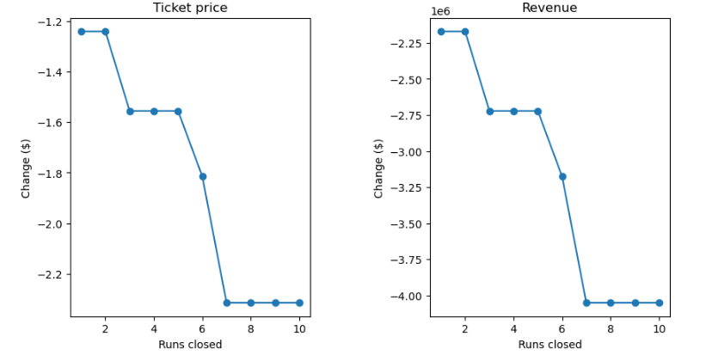
Modeling Results and Analysis
Correlation: Ticket Price and Open Runs
Potential cost savings from closing up to five runs
Minimal impact on ticket value
Assessment of customer perception and ticket price with fewer open runs
Figure C: While value of lift tickets generally decreases with fewer open runs, closing up to five runs can result in some savings on upkeep with minimal impact on ticket value.

Slide 8
Summary and Conclusion
Summary of Findings
Competitive pricing with potential for a slight increase
Exploration of additional revenue streams and cost-saving measures
Conclusion
Importance of data-driven decision-making for optimizing operations
Need for continuous data monitoring and analysis
Next steps: Implementing recommended strategies and further data collection
Final Thoughts
Balancing operational efficiency with customer satisfaction
Preparing for future investments and market changes

